Slide 1





VISUALIZING FINANCIAL TRENDS: A DEEP LEARNING APPROACH USING STOCK BAR CHART IMAGES FOR ALGORITHMIC TRADING
PRESENTED BY:
SANJAY R(2348055)
GUIDE: DR SATHYA P
MSc Data Science
Department of Statistics and Data Science
MISSION
CHRIST is a nurturing ground for an individual’s holistic development to make effective contribution to the society in a dynamic environment
VISION
Excellence and Service
CORE VALUES
Faith in God | Moral Uprightness
Love of Fellow Beings
Social Responsibility | Pursuit of Excellence

Slide 2
INTRODUCTION
MISSION
CHRIST is a nurturing ground for an individual’s holistic development to make effective contribution to the society in a dynamic environment
VISION
Excellence and Service
CORE VALUES
Faith in God | Moral Uprightness
Love of Fellow Beings
Social Responsibility | Pursuit of Excellence

Slide 3

CHRIST
Deemed to be University
INTRODUCTION
In recent years, the use of advanced computational methods in finance has grown, particularly in algorithmic trading, due to the increasing complexity and volume of financial data. Traditional methods often fall short in capturing the intricate patterns needed for accurate market predictions. This has led to a rise in using deep learning models to improve prediction accuracy and decision-making.
Convolutional Neural Networks (CNNs) are a type of deep learning model well-suited for analyzing images. They excel at detecting patterns and features effectively, making them ideal for processing visual data. In financial markets, stock price movements are commonly visualized using bar charts, which provide a snapshot of price trends over time.
This study introduces a novel approach by using CNNs to analyze stock bar chart images. By converting time series data into 30x30 pixel images, the CNN model can generate trading signals like "Buy," "Sell," or "Hold." The goal is to evaluate how well would the developed model predicts trading decisions compared to traditional strategies, such as the Buy and Hold (BaH) approach.
Overall, this research aims to improve trading predictions by leveraging visual data and deep learning techniques, offering new insights into financial forecasting and trading strategies.
Excellence and Service

Slide 4
MOTIVATION
MISSION
CHRIST is a nurturing ground for an individual’s holistic development to make effective contribution to the society in a dynamic environment
VISION
Excellence and Service
CORE VALUES
Faith in God | Moral Uprightness
Love of Fellow Beings
Social Responsibility | Pursuit of Excellence

Slide 5
CHRIST
Deemed to be University
MOTIVATION
The motivation behind the paper "Visualizing Financial Trends: A Deep Learning Approach Using Stock Bar Chart Images for Algorithmic Trading" arises from several key factors:
Limitations of Traditional Methods: Traditional trading models such as moving averages ARIMA Regression analysis, often rely on numerical data, which can miss complex patterns, leading to less effective trading decisions
.
2.Advances in Deep Learning: With the success of convolutional neural networks (CNNs) in image processing, the study explores it’s potential in financial trading.
. 3. Visual Data Representation: The study leverages Histogram images to provide richer insights, aiming to capture patterns overlooked by raw numerical data.
4. Enhanced Trading Performance: The goal is to develop a model that predicts buy, sell, and hold signals using visual data, outperforming traditional methods in different market conditions.
5.Exploring New Approaches: This paper pushes boundaries by applying CNNs to bar chart images for algorithmic trading, contributing to innovative financial forecasting strategies.
The motivation is to harness deep learning and visual analysis to improve financial decision-making.
Excellence and Service

Slide 6
LITERATURE REVIEW
MISSION
CHRIST is a nurturing ground for an individual’s holistic development to make effective contribution to the society in a dynamic environment
VISION
Excellence and Service
CORE VALUES
Faith in God | Moral Uprightness
Love of Fellow Beings
Social Responsibility | Pursuit of Excellence

Slide 7
CHRIST
Deemed to be University
Paper 1: Sentiment Analysis for Financial Markets Using Machine Learning Techniques
Authors: E. Gilbert, D. Karahalios, and R. Malouf
Abstract: This paper focuses on the application of sentiment analysis to financial markets, using machine learning techniques to analyze news articles and social media posts. The authors find that sentiment data can significantly impact stock price movements, particularly in the case of large market events such as earnings reports or geopolitical developments. The study shows that sentiment analysis can be used as an effective tool for predicting short-term price movements and volatility.
Research Gap: The paper does not explore how sentiment analysis can be combined with traditional financial models such as fundamental analysis or technical analysis. Additionally, the authors do not consider how sentiment data from different sources (e.g., social media, news, blogs) might be weighted differently in the model. There is also limited discussion on the potential for sentiment data to be manipulated, particularly in the case of social media platforms.
Dataset Used: News articles and social media data, combined with historical stock price data.
Methodology Used: The authors apply sentiment analysis tools to quantify sentiment in news articles and social media posts. They then input this sentiment data into machine learning models to predict stock price movements.
Excellence and Service

Slide 8
CHRIST
Deemed to be University
Paper 2: An Empirical Comparison of Machine Learning Models for Stock Price Prediction
Authors: K. Atsalakis, E. Valavanis, and E. Zopounidis
Abstract: This paper compares the performance of several machine learning models, including Decision Trees and SVMs for stock price prediction. The authors use a comprehensive dataset of historical stock prices from various global markets and evaluate the models based on their prediction accuracy and computational efficiency. The findings suggest that no single model consistently outperforms others, and the choice of model depends on the specific characteristics of the stock market being analyzed.
Research Gap: The paper does not explore the potential benefits of ensemble models, which combine the strengths of different machine learning techniques. Additionally, the authors do not consider the impact of high-frequency trading on the performance of these models. There is also a lack of discussion on how macroeconomic variables or alternative data sources can be incorporated into the models to improve prediction accuracy.
Dataset Used: Historical stock price data from global stock exchanges, including the NYSE, NASDAQ, and LSE.
Methodology Used: The authors conduct an empirical comparison of machine learning models, using historical stock price data for training and testing. They evaluate the models based on metrics such as Mean Absolute Error (MAE) and Mean Squared Error (MSE).
Excellence and Service

Slide 9
CHRIST
Deemed to be University
Paper 3: Application of Artificial Neural Networks in stock price prediction: A review
Authors: L. Nair, P. Choudhary, and M. Ghosh
Abstract: This review paper examines the application of Artificial Neural Networks (ANNs) in stock price prediction. The authors discuss various ANN architectures, including feedforward, recurrent, and deep neural networks, and how they have been applied to financial forecasting. The paper highlights the advantages of using ANNs in capturing non-linear relationships in stock prices and discusses common challenges such as overfitting and data preprocessing.
Research Gap: The review does not delve into how ANN models can be combined with other machine learning techniques to improve accuracy and robustness. Additionally, the authors do not explore the role of alternative data sources, such as social media sentiment or macroeconomic indicators, in enhancing ANN performance. There is also limited discussion on the interpretability of ANN models in a financial context.
Dataset Used: The review covers a range of datasets used in previous studies, including historical stock prices, forex data, and commodity prices.
Methodology Used: The authors review existing literature on the application of ANN models in financial forecasting. They categorize the studies based on the type of ANN architecture used and provide a detailed discussion of the challenges and limitations associated with each approach.
Excellence and Service

Slide 10
CHRIST
Deemed to be University
Paper 4: Intraday Prediction of Borsa Istanbul using Convolutional Neural Networks and Feature Correlations
Authors: H. Gunduz, Y. Yaslan, and Z. Cataltepe
Abstract: This paper applies Convolutional Neural Networks (CNNs) for intraday stock price prediction on the Borsa Istanbul. It investigates how feature correlations can enhance CNN model performance and explores the potential for improving the accuracy of intraday predictions using high-dimensional financial data. The study shows that CNNs can capture non-linear relationships between features, leading to more accurate predictions of short-term price movements.
Research Gap: While the paper focuses on CNNs, it does not compare their performance with other deep learning models such as LSTMs or hybrid models. The authors also do not consider the scalability of CNNs in real-time trading environments, particularly in the context of high-frequency trading.
Dataset Used: High-frequency intraday stock price data from the Borsa Istanbul.
Methodology Used: The authors use CNNs to analyze intraday stock price data, focusing on feature correlations to improve model performance. They train the CNN model using high-frequency financial data and evaluate its performance based on intraday price predictions.
Excellence and Service

Slide 11
RESEARCH GAP
MISSION
CHRIST is a nurturing ground for an individual’s holistic development to make effective contribution to the society in a dynamic environment
VISION
Excellence and Service
CORE VALUES
Faith in God | Moral Uprightness
Love of Fellow Beings
Social Responsibility | Pursuit of Excellence

Slide 12
CHRIST
Deemed to be University
RESEARCH GAP
The research gap identified in the paper "Visualizing Financial Trends: A Deep Learning Approach Using Stock Bar Chart Images for Algorithmic Trading" can be summarized as follows:
Limited Use of Visual Data in Financial Models: While there has been extensive research on using numerical time series data for financial forecasting and trading, there is a notable lack of studies that utilize visual representations of financial data, such as bar charts, in algorithmic trading models. This paper addresses this gap by proposing a novel approach that directly employs 2-D images of stock price movements.
Underexplored Application of CNNs in Finance: Although convolutional neural networks (CNNs) have been widely applied in image classification tasks across various fields, their application in financial trading and forecasting remains limited. The paper seeks to fill this gap by demonstrating how CNNs can be effectively used to analyze stock bar chart images for predicting trading signals.
Integration of Deep Learning with Trading Strategies: The existing literature primarily focuses on traditional machine learning techniques for financial analysis, with fewer studies exploring the integration of deep learning models into trading strategies. This research aims to bridge that gap by developing a deep learning-based trading model (CNN-BI) that utilizes visual data for decision-making.
Excellence and Service

Slide 13
PRIMARY OBJECTIVE
MISSION
CHRIST is a nurturing ground for an individual’s holistic development to make effective contribution to the society in a dynamic environment
VISION
Excellence and Service
CORE VALUES
Faith in God | Moral Uprightness
Love of Fellow Beings
Social Responsibility | Pursuit of Excellence

Slide 14
CHRIST
Deemed to be University
PRIMARY OBJECTIVE
Transforming Time Series Data: To convert one-dimensional financial time series data into two-dimensional images (30x30 pixel bar charts) that visually represent stock price movements over a 30-day period.
Predicting Trading Signals: To train a deep CNN model on these images to classify them into trading signals—specifically "Buy," "Sell," and "Hold"—thereby aiding in decision-making for algorithmic trading.
Evaluating Model Performance: To assess the effectiveness of the CNN-BI model in predicting trading signals and to compare its performance against traditional trading strategies, particularly the Buy and Hold (BaH) strategy, across different market conditions.
Exploring Unconventional Approaches: To investigate the potential of using visual data representations in financial forecasting and trading, thereby contributing to the existing literature by demonstrating a new methodology that leverages deep learning techniques.
Overall, the primary objective is to enhance trading performance through the innovative use of visual data and deep learning, providing a new perspective on algorithmic trading strategies.
Excellence and Service

Slide 15
SECONDARY OBJECTIVE
MISSION
CHRIST is a nurturing ground for an individual’s holistic development to make effective contribution to the society in a dynamic environment
VISION
Excellence and Service
CORE VALUES
Faith in God | Moral Uprightness
Love of Fellow Beings
Social Responsibility | Pursuit of Excellence

Slide 16
CHRIST
Deemed to be University
SECONDARY OBJECTIVE
Demonstrating the Effectiveness of CNNs: To showcase the capability of convolutional neural networks (CNNs) in processing and analyzing financial data represented as images, thereby highlighting their potential advantages over traditional numerical analysis methods.
Comparative Analysis with Existing Models: To conduct a comparative analysis of the proposed CNN-BI model against other established trading strategies and models, such as traditional machine learning techniques(Decision Trees, SVM, Random Forests ) and the Buy and Hold (BaH) strategy, to evaluate its relative performance and effectiveness.
Exploring Market Conditions: To investigate how the proposed model performs under different market conditions (e.g., bull, bear, and trendless markets) by testing it on historical data from distinct time periods (2008-2018 and 2018-2023.). This aims to provide insights into the robustness and adaptability of the model.
Identifying Areas for Improvement: To recognize the limitations of the proposed approach and identify potential areas for future research and improvement, given that this study represents a preliminary exploration of using visual data in financial trading.
Overall, the secondary objectives focus on validating the proposed model's effectiveness, exploring its performance across various conditions, and contributing to the broader field of financial analysis and trading strategies.
Excellence and Service

Slide 17
DATA COLLECTION
MISSION
CHRIST is a nurturing ground for an individual’s holistic development to make effective contribution to the society in a dynamic environment
VISION
Excellence and Service
CORE VALUES
Faith in God | Moral Uprightness
Love of Fellow Beings
Social Responsibility | Pursuit of Excellence

Slide 18
CHRIST
Deemed to be University
DATA COLLECTION
Time Periods for Data Collection: We can collect historical stock price data for two distinct time periods: 2008-2018 and 2018-2023. This allows for the evaluation of the model's performance across different market conditions, including both bullish and bearish trends.
Data Source: The data was collected from finance.yahoo.com. which provides historical stock price information, including daily open, high, low, and close prices.
Image Generation: The collected time series data is transformed into visual representations. Specifically, the authors generate 2-D images of sliding windows of 30-day bar charts for each stock. Each image represents the stock price movements over a 30-day period, which is then used as input for the convolutional neural network.
Labeling of Images: Each generated image is labeled with one of three trading signals: "Buy," "Sell," or "Hold." These labels are based on the predicted trading actions derived from the model's analysis of the stock price movements.
Preprocessing: Data preprocessing involves normalizing 30-day stock price windows and converting them into 30x30 pixel bar chart images, where the y-axis represents stock prices and the x-axis represents time. These binary images are used for training the CNN model.
Excellence and Service

Slide 19

METHODOLOGY
Image Creation
Labelling Data
Predicting Label(CNN)
Financial Evaluation
Dataset(E/T)
MISSION
CHRIST is a nurturing ground for an individual’s holistic development to make effective contribution to the society in a dynamic environment
VISION
Excellence and Service
CORE VALUES
Faith in God | Moral Uprightness
Love of Fellow Beings
Social Responsibility | Pursuit of Excellence

Slide 20
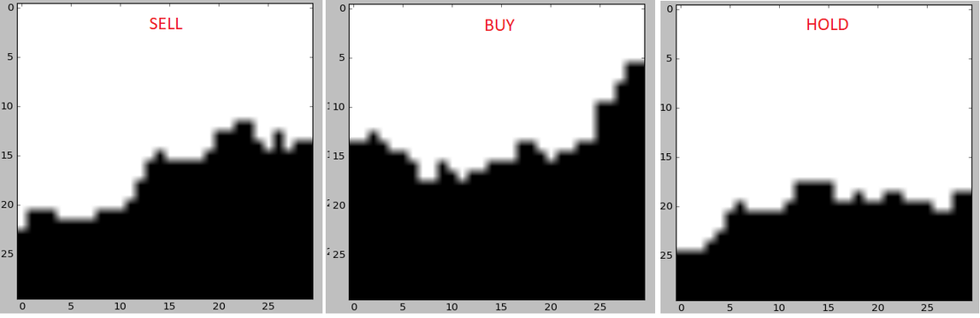
CHRIST
Deemed to be University
METHODOLOGY
1. Data Collection and Preparation:
Stock Selection: The study focuses on the collecting historical price data of all stocks for two distinct periods: 2008-2018 and 2018-2023.
Image Generation: The time series stock price data is transformed into 2-D images. Specifically, a sliding window of 30 days is used to create bar chart images, where each image represents the stock prices over a 30-day period, resulting in 30x30 pixel images.
2. Image Labeling:
Each generated image is labeled with one of three trading signals: "Buy," "Sell," or "Hold." This labeling is based on the calculated slopes of the stock prices, which indicate the future trend of the prices. The current slope is also computed to determine the appropriate label for each image.
Excellence and Service

Slide 21
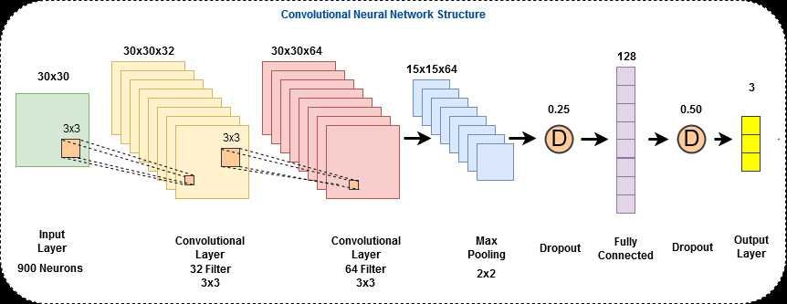
CHRIST
Deemed to be University
METHODOLOGY
3. Model Development:
Convolutional Neural Network (CNN): A deep convolutional neural network is designed to process the labeled bar chart images. The CNN architecture is tailored to classify the images into the defined trading signals.
Training the Model: The CNN is trained using the prepared dataset of images and their corresponding labels. The training process involves optimizing the model parameters to minimize the classification error.
4. Model Evaluation:
The performance of the trained CNN model is evaluated on separate test datasets that were not used during training. This evaluation assesses the model's ability to predict trading signals accurately.
The results are compared against traditional trading strategies, particularly the Buy and Hold (BaH) strategy, to determine the effectiveness of the CNN-based approach.
Excellence and Service

Slide 22
CHRIST
Deemed to be University
METHODOLOGY
5. Analysis of Results:
The study analyzes the model's performance across different market conditions, examining how well it performs in both bullish and bearish markets. This analysis helps to understand the robustness and adaptability of the proposed model.
6. Discussion and Future Work:
The paper discusses the implications of the findings, the limitations of the current study, and potential areas for future research and improvement in the methodology.
Overall, the methodology emphasizes the innovative use of visual data representations in financial trading, leveraging deep learning techniques to enhance decision-making in algorithmic trading.
Excellence and Service

Slide 23
INVESTIQ
MISSION
CHRIST is a nurturing ground for an individual’s holistic development to make effective contribution to the society in a dynamic environment
VISION
Excellence and Service
CORE VALUES
Faith in God | Moral Uprightness
Love of Fellow Beings
Social Responsibility | Pursuit of Excellence

Slide 24
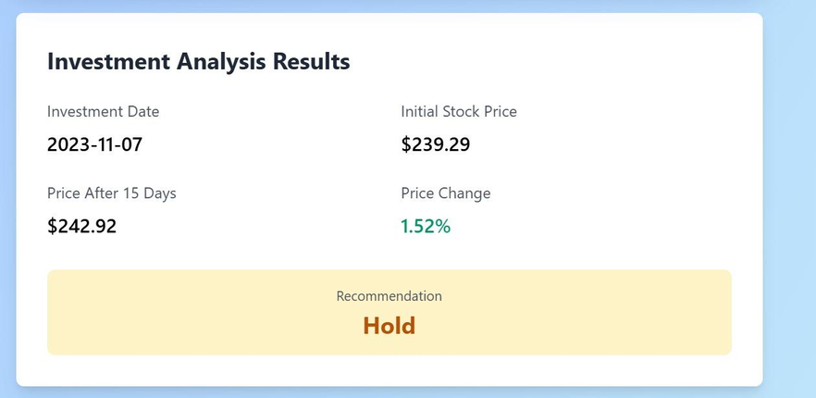
WORKING OF INVESTIQ
🔹Data Input & Investment Date:
User inputs an investment date.
System fetches & preprocesses stock data (cleaning, normalization, train-test split).
Enables flexible predictions for different periods.
🔹 Model Training & Evaluation:
Model trains on historical data using multiple epochs.
Tracks loss & validation accuracy for performance monitoring.
Prevents overfitting & ensures generalization.
🔹 Stock Price Prediction & Investment Decision:
Predicts stock price movement over 15 days.
Compares initial vs. predicted price.
MISSION
CHRIST is a nurturing ground for an individual’s holistic development to make effective contribution to the society in a dynamic environment
VISION
Excellence and Service
CORE VALUES
Faith in God | Moral Uprightness
Love of Fellow Beings
Social Responsibility | Pursuit of Excellence

Slide 25
CONCLUSION
MISSION
CHRIST is a nurturing ground for an individual’s holistic development to make effective contribution to the society in a dynamic environment
VISION
Excellence and Service
CORE VALUES
Faith in God | Moral Uprightness
Love of Fellow Beings
Social Responsibility | Pursuit of Excellence

Slide 26
CHRIST
Deemed to be University
CONCLUSION
✅Effectiveness of CNN-BI Model
Successfully predicts trading signals ("Buy," "Sell," and "Hold") using 2D stock price bar chart images.
Outperforms traditional Buy and Hold (BaH) strategy, especially in bear or trendless markets.
✅ Novelty of Approach
Utilizes visual data representations instead of traditional numerical time series.
Highlights the potential of deep learning in financial forecasting.
✅ Model Adaptability:
Demonstrates effectiveness across different market conditions.
Recognized as a preliminary exploration, requiring further refinement.
✅Future Improvements:
Optimizing the CNN-BI model architecture for improved accuracy.
Integrating with other trading strategies to boost overall performance.
Expanding the method to other financial instruments beyond stock trading.
Excellence and Service

Slide 27
REFERENCES
MISSION
CHRIST is a nurturing ground for an individual’s holistic development to make effective contribution to the society in a dynamic environment
VISION
Excellence and Service
CORE VALUES
Faith in God | Moral Uprightness
Love of Fellow Beings
Social Responsibility | Pursuit of Excellence

Slide 28
CHRIST
Deemed to be University
REFERENCES
1] R. Aguilar-Rivera, M. Valenzuela-Rendon, JJ. Rodrguez-Ortiz, Genetic algorithms and Darwinian approaches in financial applications: A survey, Expert Systems with Applications 42.2, (2015) pp. 7684-7697.
[2] A. Canziani, A. Paszke, E. Culurciello, An analysis of deep neural network models for practical applications(2016) ArXiv: 1605.07678.
[3] R.C. Cavalcante, R.C. Brasileiro, V. Souza, J.P. Nobrega, A.L.I. Oliveira, Computational intelligence and financial markets: A survey and future directions, Expert Systems with Applications 55, (2016) pp. 194-211.
[4] J. Chen et al., Financial Time-Series Data Analysis Using Deep Convolutional Neural Networks, Cloud Computing and Big Data (CCBD), 7th International Conference on. IEEE, (2016) pp. 87-92.
[5] A. Chen, M.T. Leung, H. Daouk, Application of neural networks to an emerging financial market: forecasting and trading the Taiwan Stock Index, Computers & Operations Research 30.6, (2003) pp. 901-923.
[6] D.C. Ciresan et al., Convolutional neural network committees for handwritten character classification, Document Analysis and Recognition (IC-DAR), International Conference on. IEEE, (2011) pp. 1135-1139.
[7] X. Ding et al., Deep Learning for Event-Driven Stock Prediction, International Joint Conference on Artificial Intelligence, (2015) pp. 2327-2333.
Excellence and Service

Slide 29
CHRIST
Deemed to be University
REFERENCES
[8] D. Enke, N. Mehdiyev, Stock market prediction using a combination of stepwise regression analysis, differential evolution-based fuzzy clustering, and a fuzzy inference neural network, Intelligent Automation & Soft Computing 19.4, (2013) 636–648.
[9] T. Fischer, C. Krau, Deep learning with long short-term memory networks for financial market predictions, Tech. rep. FAU Discussion Papers in Economics, (2017).
[10] I. Goodfellow, Y. Bengio, A. Courville, Deep Learning, MIT Press, (2016).
[11] E. Guresen, G. Kayakutlu, T.U. Daim, Using artificial neural network models in stock market index prediction, Expert Systems with Applications 38.8, (2011) pp. 10389-10397.
[12] A. Karpathy et al., Large-scale video classification with convolutional neural networks, Proceedings of the IEEE conference on Computer Vision and Pattern Recognition, (2014) pp. 1725-1732.
[13] N. Kalchbrenner, E. Grefenstette, P. Blunsom, A convolutional neural network for modelling sentences, (2014) ArXiv: 1404.2188.
[14] L. Kaelan, V. Kaelan, M. Jovanovi, Hybrid support vector machine rule extraction method for discovering the preferences of stock market investors: Evidence from Montenegro, Intelligent Automation & Soft Computing 21.4, (2015) 503–522.
Excellence and Service

Slide 30
CHRIST
Deemed to be University
REFERENCES
\[15] C. Krauss, X. Do, N. Huck, Deep neural networks, gradient-boosted trees, random forests: Statistical arbitrage on the S&P 500, European Journal of Operational Research 259.2, (2017) pp. 689-702.
[16] Y. Kim, Convolutional neural networks for sentence classification, (2014) ArXiv: 1408.5882.
[17] A. Krizhevsky, I. Sutskever, G. Hinton, ImageNet classification with deep convolutional neural networks, Advances in neural information processing systems, (2012) pp. 1097-1105.
[18] B. Krollner, B. Vanstone, G. Finnie, Financial time series forecasting with machine learning techniques: A survey, European Symposium on Artificial Neural Networks Computational Intelligence and Machine Learning, (2010).
[19] Y.K. Kwon, B.R. Moon, A hybrid neurogenetic approach for stock forecasting, IEEE Transactions on Neural Networks 18.3, (2007) pp. 851-864.
[20] M. Langkvist, L. Karlsson, A.Loutfi, A review of unsupervised feature learning and deep learning for time-series modeling, Pattern Recognition Letters 42, (2014), pp. 11-24.
[21] S. Lawrence et al., Face recognition: A convolutional neural-network approach, IEEE transactions on neural networks 8.1., (1997) pp. 98-113.
[22] Y. LeCun et al., Learning algorithms for classification: A comparison on handwritten digit recognition, Neural networks: the statistical mechanics perspective, (1995) 265.
[23] Y. LeCun, Y. Bengio, G. Hinton, Deep learning, Nature 521.7553, (2015) pp. 436-444.
[24] Z. Liao, J. Wang, Forecasting model of global stock index by stochastic time effective neural network, Expert Systems with Applications 37.1, (2010) pp. 834-841.
[25] O.B. Sezer, A.M. Ozbayoglu, E. Dogdu, An Artificial Neural Network-based Stock Trading System Using Technical Analysis and Big Data Framework, ACM Proceedings of the South East Conference, (2017) pp. 223-226.
Excellence and Service

Slide 31
CHRIST
Deemed to be University
THANK YOU
Excellence and Service

